Slide 1

Migration and Immigration
The edge of heaven

Slide 2

What are the differences between these things:
migration
immigration
urbanization
gentrification
3 minutes. Go talk in groups and figure it out
Notes:
To get students better know what “Experience” means
What are the commonalities between these words?—people’s movement

Slide 3
migration (n)
the movement of large numbers of people from one place to another
movement of people to a new area or country in order to find work or better living conditions
When everyone in China goes to their hometowns to be with their families for Chinese New Year, that is the world's biggest annual human migration.
immigration (n)
the process of going to live permanently in a country that is not your own
migration into a place (especially migration to a country of which you are not a native in order to settle there) – think Chinatowns in Western countries
urbanization (n)
the social process in which people move from rural areas to live in cities
gentrification (n)
when the middle class moves into and improves decaying or run-down urban areas, which forces out low-income residents who have lived there for many years
Notes:
Migration: not about people’s intention
Gentrification: a process of neighborhood change that includes economic change in a historically disinvested neighborhood

Slide 4

As gentrification continues with more middle class residents moving in, more businesses will invest to cater to these people. The neighborhood will slowly become more upscale (relatively expensive and designed to appeal to affluent or wealthy consumers).
The prices of everything in the area will rise, such as the price of daily necessities like grocery costs.
This would then force out most of the remaining low-income residents who have been there for years.
Notes:
For the people who lived in the city before: They were not really physically "expelled", but forced to leave because they could not afford the prices and the level of consumption.

Slide 5
German-Turkish co-production
Is it more productive to think about it in terms of "transnational," "hybrid," "accented," or "third space" cinema?
"Transnational"/"hybrid"/"accented" cinema versus "German", "national" cinema
Focus on hybrid spaces between cultures, neither at home in country of one's parents nor in country of birth
• See e.g. Naficy, Hamid. An Accented Cinema: Exilic and Diasporic Filmmaking. Princeton: Princeton UP, 2001.
"Third spaces" of cultural hybridity hold out promise of more liberated society
Experimentation with new ways of inhabiting "Germanness" or "Europeanness"
• Directors such as Maccarone, Fatih Akin

Slide 6

The Socio-Political Context
In 1997 Turkey was declared eligible to join the EU
Negotiations were commenced in 2004, yet in 2008 the EU determined that a series of negotiation chapters would not be opened until Turkey addressed a list of priorities covering administrative, judicial, and economic issues, including its restrictions on the Republic of Cyprus and enforcement of human rights.
Human rights, freedom of expression, and the right to assembly are referenced in the
̈ depiction of the political demonstration in support of the Kurdish activist Ocalan

Slide 7
Othering of Turkish Migrants
In 1961, the Federal Republic of Germany was the first of many European countries to enter into an agreement with Turkey on labour migration to enable Turkish citizens to work in Germany as Gastarbeiter or guestworkers.
n the peak period of migration, 1970–73, half a million Turks migrated to Europe, with 90 per cent going to Germany
in 1974, Germany officially called a halt to migration, yet the size of the Turkish migrant population continued to grow as a result of family reunions.
The othering of Turkish Germans is largely a legacy of the history of post-war migration and German citizenship laws

Slide 8
How is the othering of Turkish Germans/migrants depicted in the films?

Slide 9
Can Turkish Germans embrace their identity as Turkish? Why?
In what ways, the movie suggest that Turkish Germans need to hide their Turkishness in Germany?

Slide 10
Reading
What’s the contemporary relationship between Europe and Turkey mentioned in the Edge of Heaven?
What type of relationship is desired by the “other” according to Akin?
How does Akin depict the relationship between Europe and Turkey?

Slide 13

What is transnational cinema?
Notes:
Crew from different countries, boarder crossing, mix of genre etc.
What’s the significance of transnational cinema

Slide 14

The study of transnationalism doesn’t mean to dismiss the idea of national cinema entirely, instead, it offers a dynamic mode analysis that takes into account the persistent impacts of the national as well as the cultural plurality and exchange that defines so many films today
In other words, it offers a different view to look into the impacts of national and cultural plurality that defines nowadays movies.
Cinema mode : borders, movement, language and connections

Slide 15

Transnational Identities

Slide 16
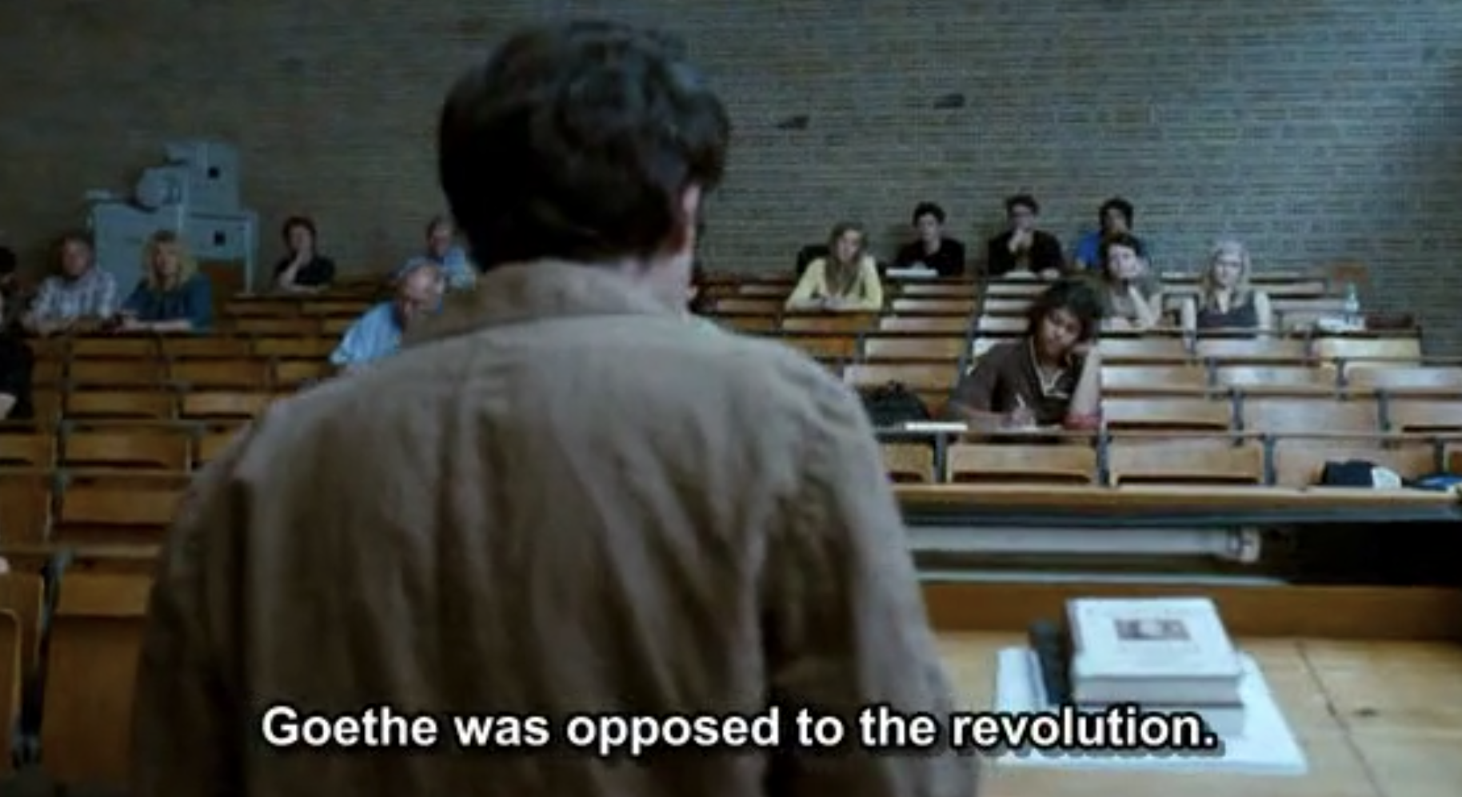






Notes:
Stress and evolutionary rather than revolutionary approach to change

Slide 17

The prominence accorded to cultural hybridity and transculturalism in the film is similarly and argument against revolution because both terms are inclusive rather than establishing competing binary opposite

Slide 18
Turkish book
Notes:
What’s the significance of this Turkish book?
When did Ali read this book? What’s the significance in that?
Self-reflective response to his own history, a historical reflection through literary narrative

Slide 19
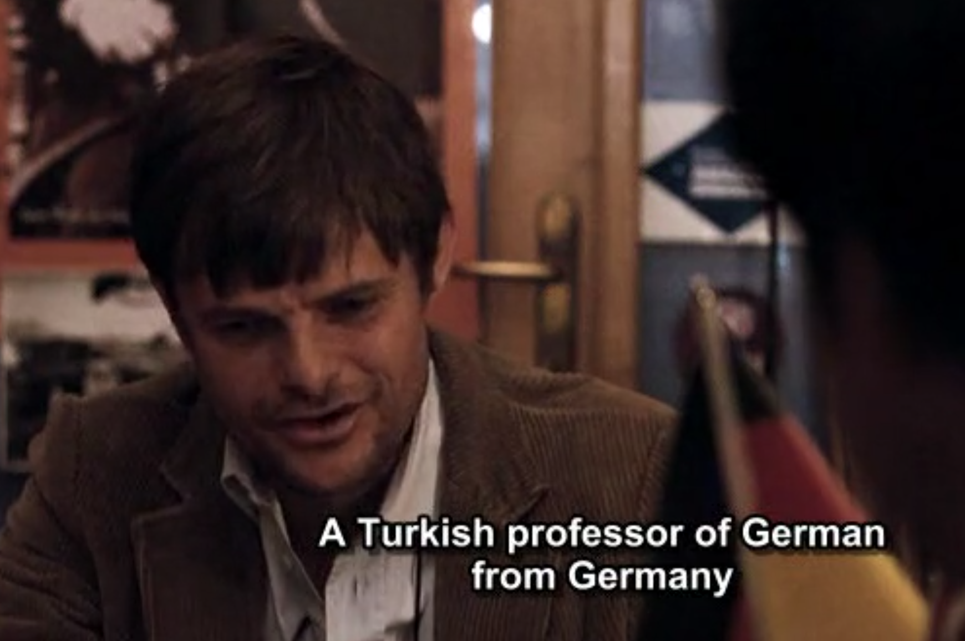

Nejat

Slide 20
How is Nejat’s transnational identity characterized in the movie?

Slide 21
What about Lotter and Susanne? Do they have hybrid/hyphenated identity?
How does the movie present their identity shifting?

Slide 22
Write a research question about The Edge of Heaven, and form an argument that could be developed into an essay
You could discuss about theme of the movie (what is the theme?), postcolonialism, transnationalism, hybrid identities, counter-hegemonic, kinship, queer etc.
Queer:
• Not just "gay" or "lesbian" (though sometimes used as an umbrella term for gay/ lesbian/ bisexual/ trans*)
• questioning of identity categories
I.e. Research question: To what extent is it an example of "queer" cinema?
Argument: The Edge of Heaven is "queer" in the way it challenges understandings of identity, as well as addressing themes of homosexuality experience

